Slide 1
TABLE NO : 73
FLIGHT BOOKING SYSTEM
(flightreserve.com)

Slide 2
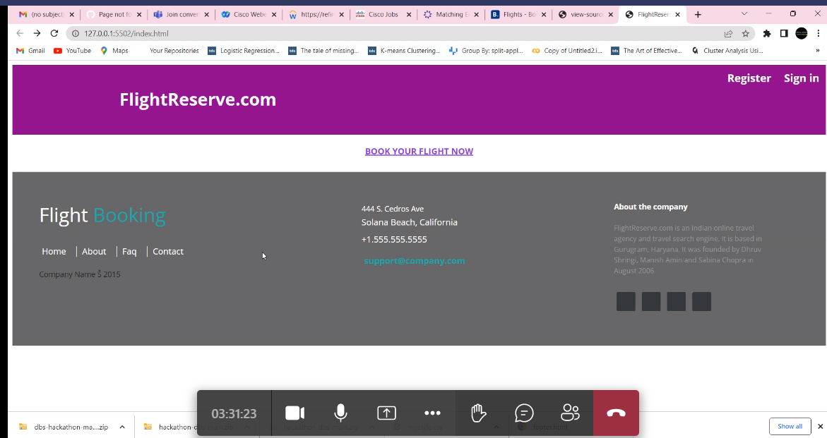
Main Page

Slide 3
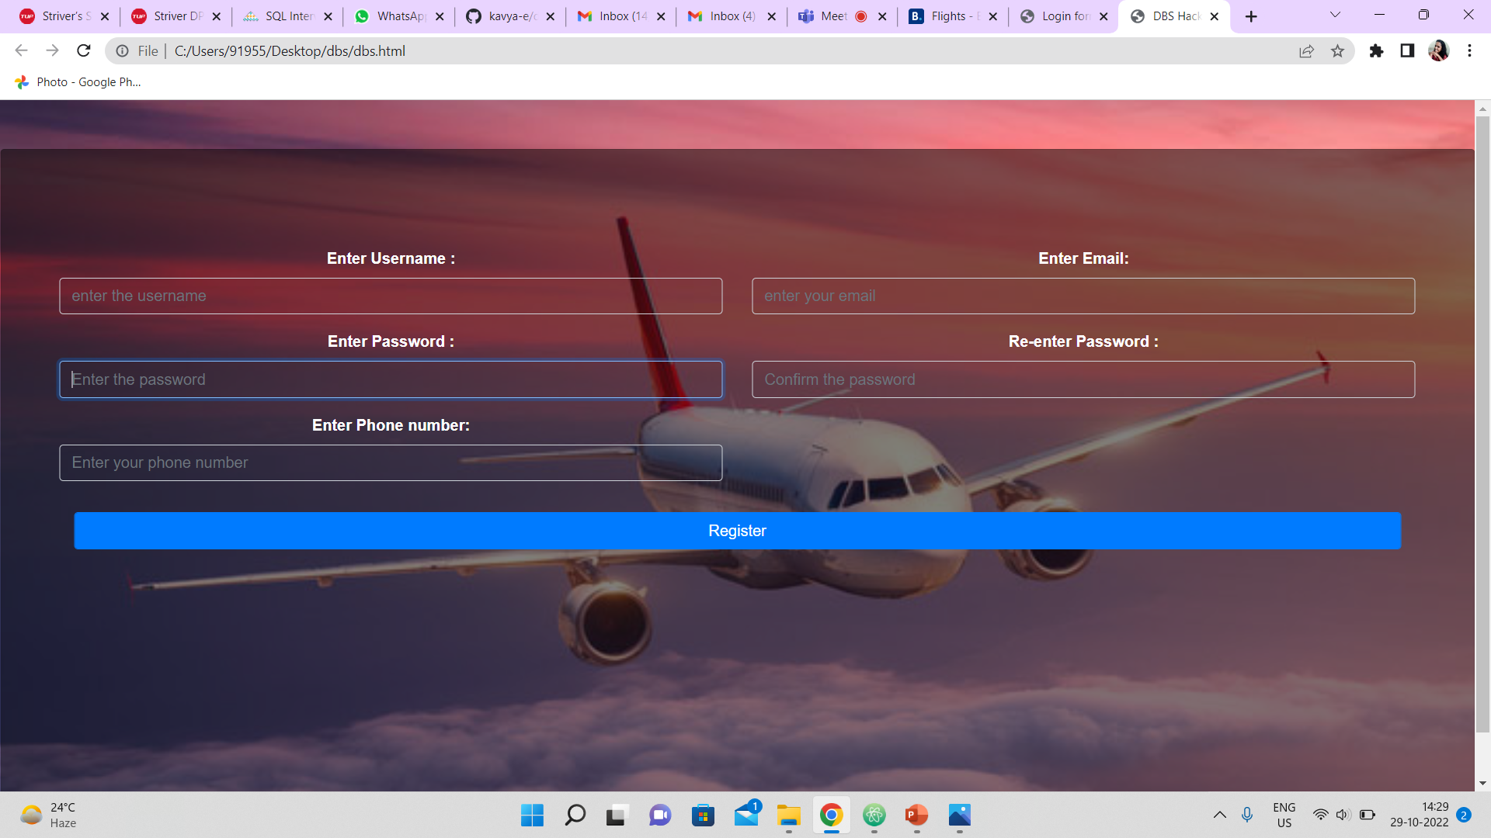
Register Page

Slide 4
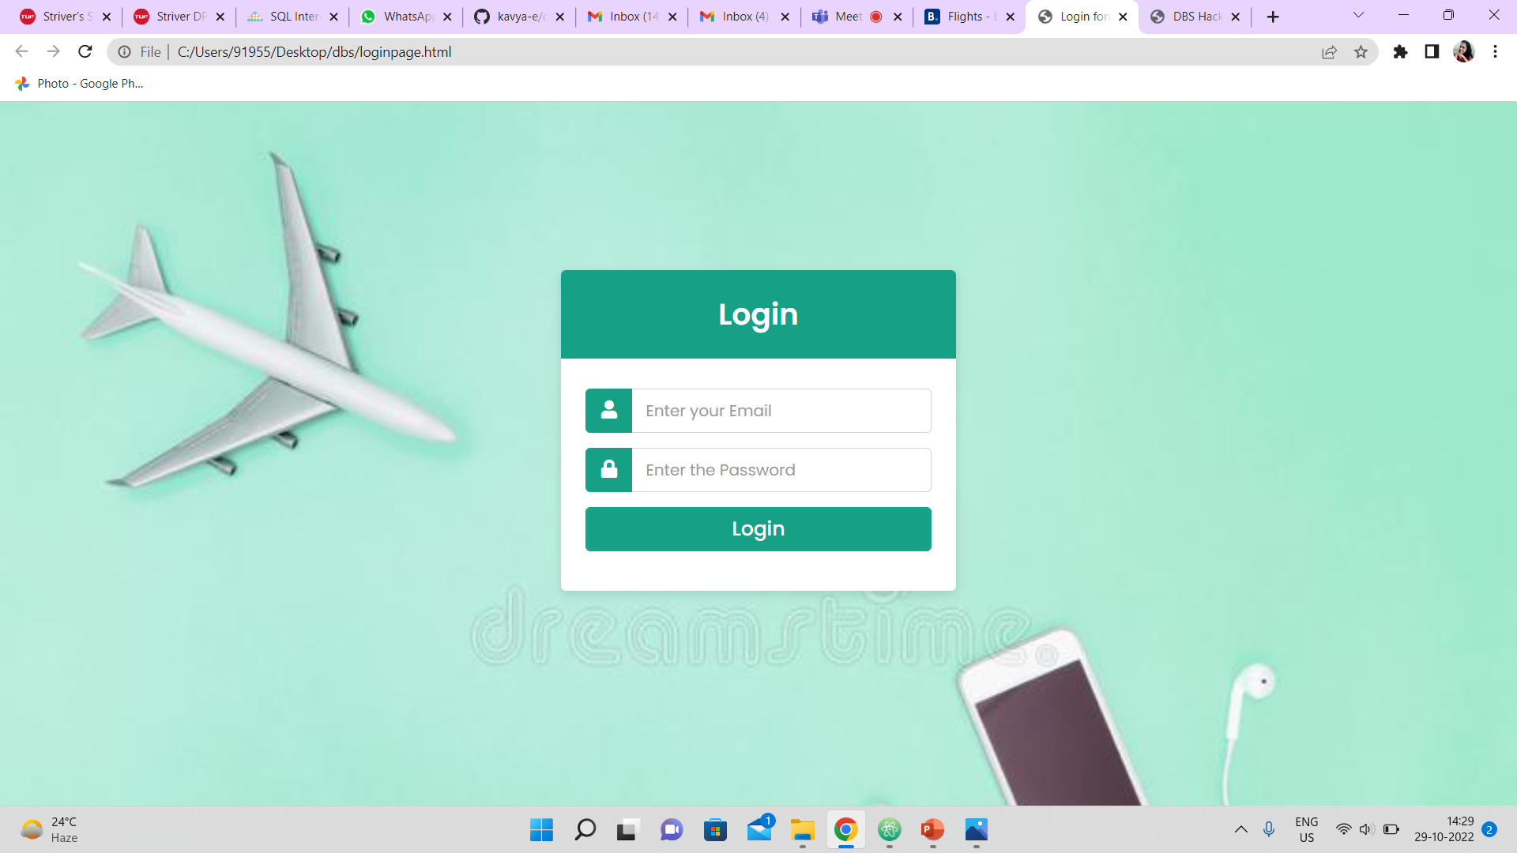
Login Page

Slide 5
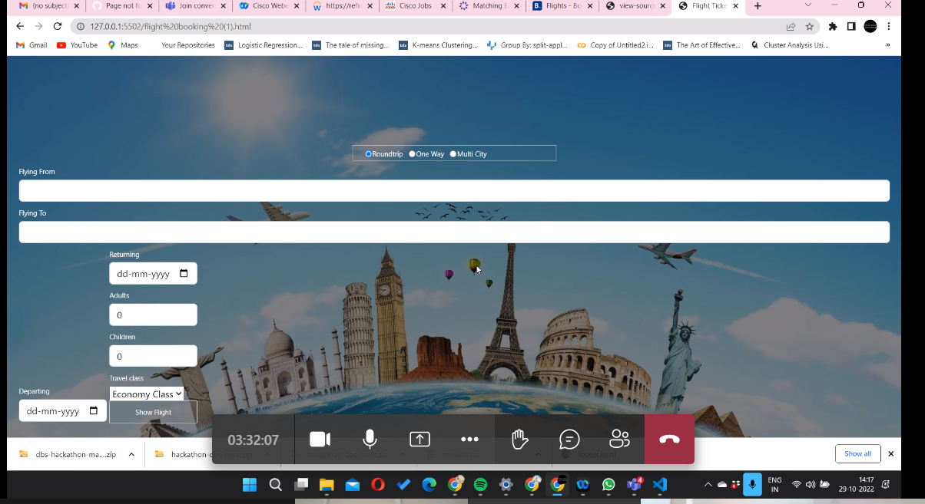
Flight Booking

Slide 6
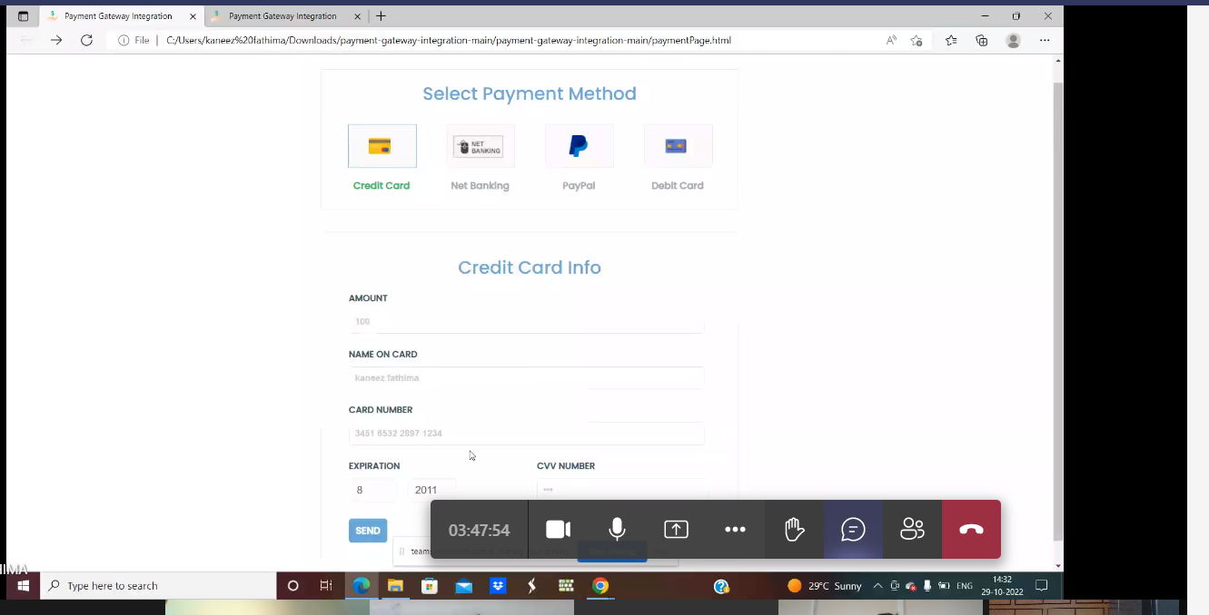
Payment Window

Slide 7
THANK YOU

